Slide 1


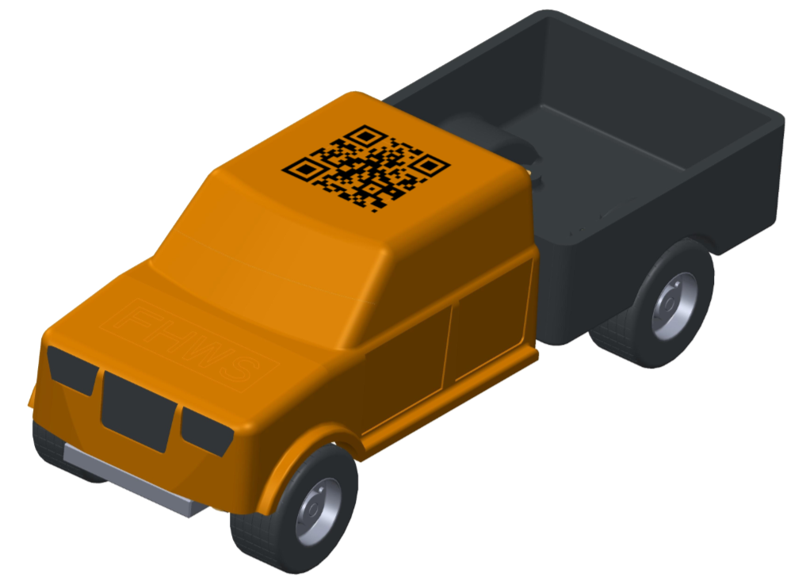
Thesis: Integration of an injection moulding machine in a host computer system
The c-factory‘s production must be improved.
Your task will be to fully integrate our ARBURG injection moulding machine with a host computer system (ARBURG ALS) into our system.
Betreuung: Prof.-Dr. Christoph Bunsen und Roland Oppelt
Kontakt: christoph.bunsen@fhws.de roland.oppelt@fhws.de

