Slide 1


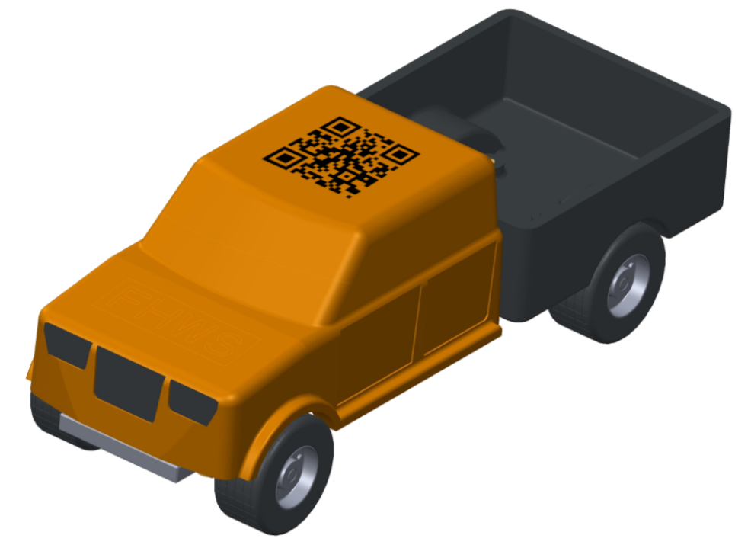
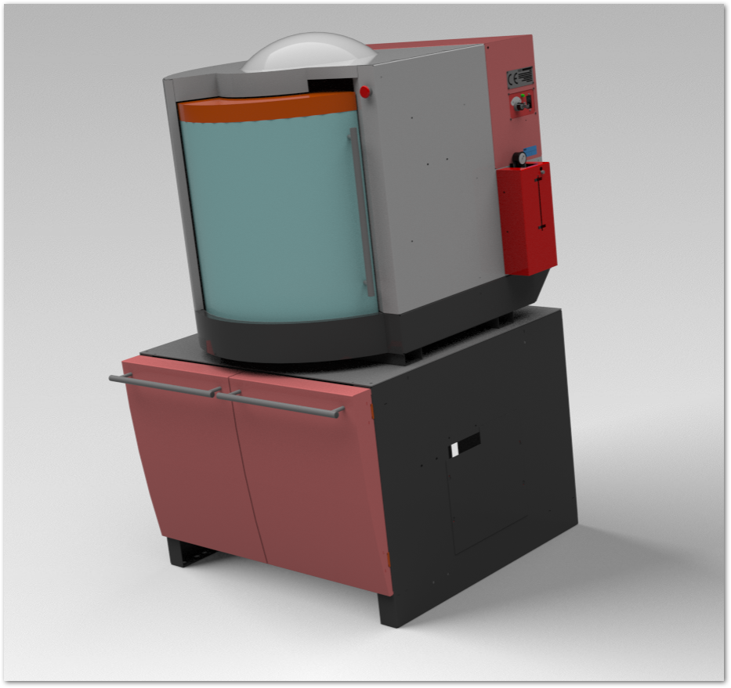
Thesis: Creation of a digital twin of the EMCO milling machine
The c-factory‘s production must be improved. The milling process takes too long.
Your task will be to create a digital twin of our EMCO milling machine in order to make improvements through simulations.
Betreuung: Prof.-Dr. Christoph Bunsen und Roland Oppelt
Kontakt: christoph.bunsen@fhws.de roland.oppelt@fhws.de

